Slide 1
CEIBA PARTNERS
BUSINESS DATA ANALYTICS

Slide 2
OUR SOLUTIONS
Enable business visibility with our tailor-made data solutions:
Operational KPIs
Reporting Packages
Enterprise-level data warehousing solutions.

Slide 3
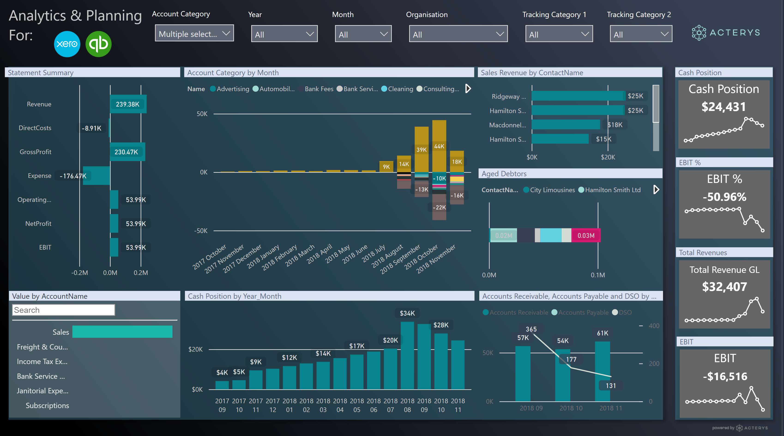
INTERACTIVE DASHBOARDS
Get the most of your data with Power BI dashboards:
Fully interactive, user-friendly experience.
For both operational and financial information.

Slide 4
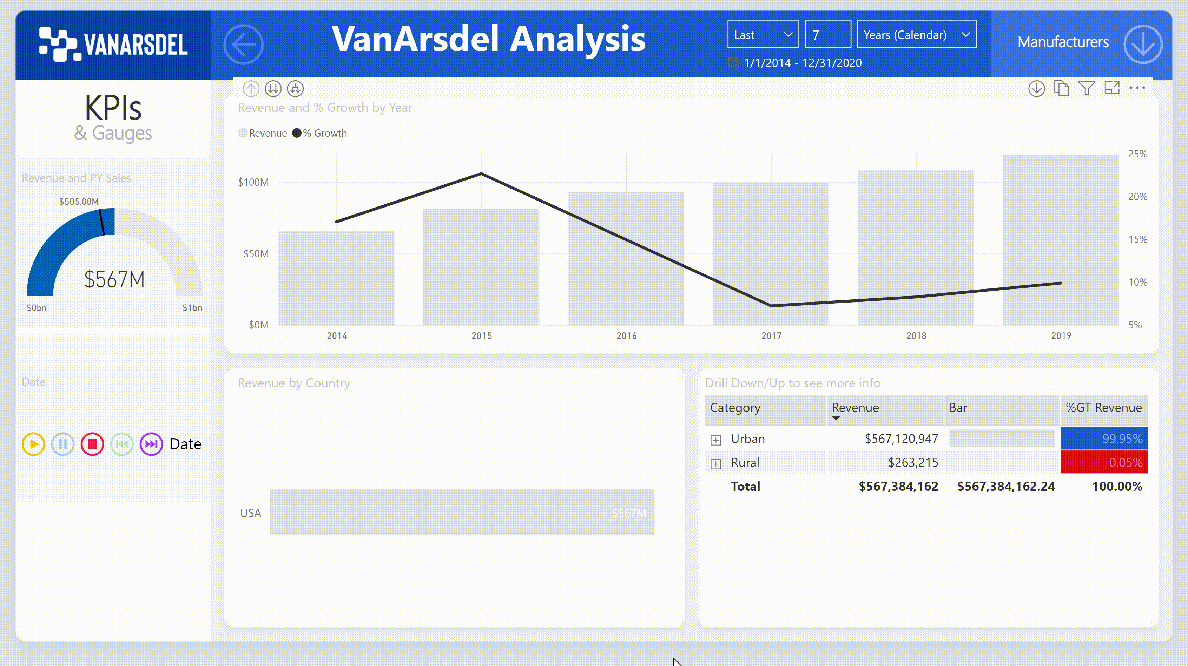
INTERACTIVE DASHBOARDS

Slide 5
Ad-Hoc Reporting Package
Ideal for executive meetings and end of month results review:
Executive summaries.
  P&L
  Contribution per client, country, etc…
  Headcount and compensation cost per cost center, country, etc.
Global reports.
Easily shared via Excel.
Printable PDF formats

Slide 6
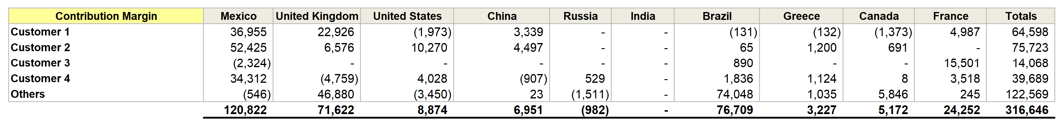
Ad-Hoc Reporting Package
  Contribution per client, country, etc.
  Headcount and compensation cost per cost center, country, etc.

Slide 7





Enterprise-level data warehouse
End-Users
Control, secure, and distribute your data globally with our data warehousing solutions:
Ideal for medium to large companies.
Ideal for companies with a need for highly available, high quality data and reports.
Create roles and assign specific security restrictions, avoid information leakage.
Reporting Layer
Semantic Layer
Data Warehouse
Extract, Transform & Load (ETL)
Source Systems
Source Systems

